Slide 1
A First Progress Report
on
KITCHEN JUNGLE
Under the supervision
of
Dr. Jaiteg Singh, Professor,
Department of Computer Applications

Slide 2
Team Details
1910992512: AKSHAY
1910992514: AMAN
1910992577: HIMANSHU
1910992512: Back end design
1910992514: Back end design
1910992577: Front end desgin

Slide 3
Introduction
Our aim for doing this project is to take restaurant business on a e-commerce platform . This will ease the restaurants to reach masses and help to increase more number of customers. Target audience includes people between 15 to 35 years of age who have access to smart phones and are comfortable in using apps. People can get their package at there doorsteps.
Notes:
Short Messaging Service
Global Positioning System/Geographic Information System
Open Base Transceiver Station
Hierarchical Random Walk-based Path Planner

Slide 4
Functionality
To increase efficiency and improve services provide to the customers.
To be able to stand out from competitors in the food services industry.
To enable customers to know food ingredients before ordering.
To reduce restaurant’s food wastage.
Improve efficiency of restaurant’s staff.

Slide 5
Introduction
Softwares Required for development of this project
1: Visual studio code
2: Languages used Angular JS, HTML , CSS and dot net
3: MYSQL

Slide 6

User Interface Screen Snap Shots

Slide 7
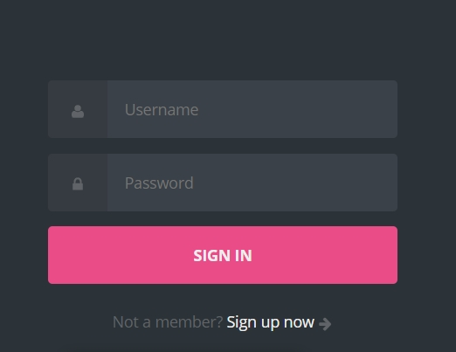
User Interface Screen Snap Shots

Slide 8
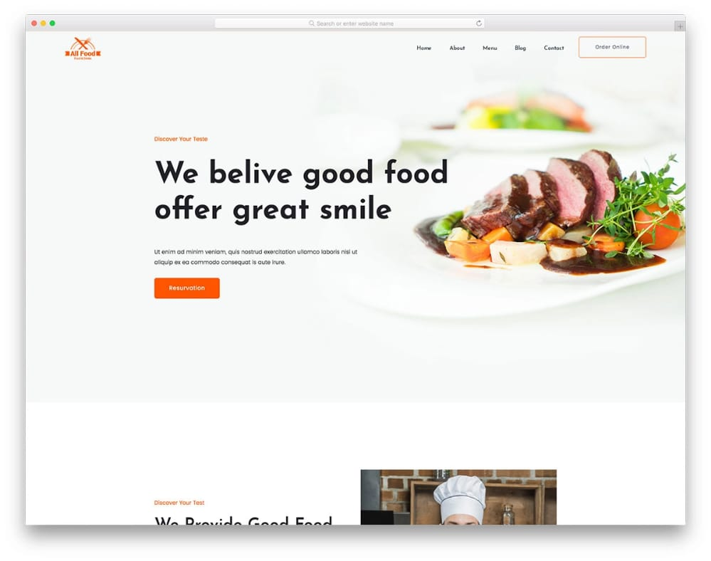
User Interface Screen Snap Shots

Slide 9
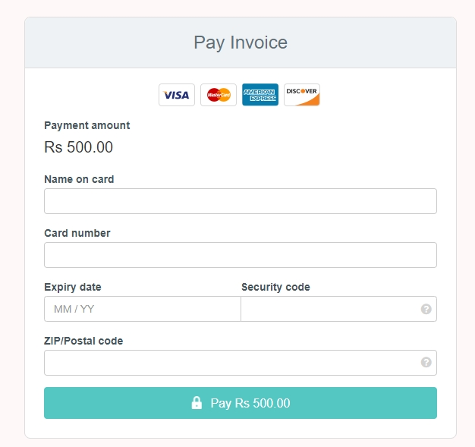
User Interface Screen Snap Shots

Slide 10
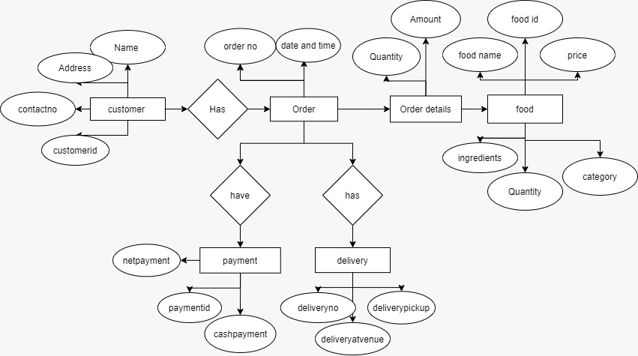
Database Design
ER Diagram[1]

Slide 11
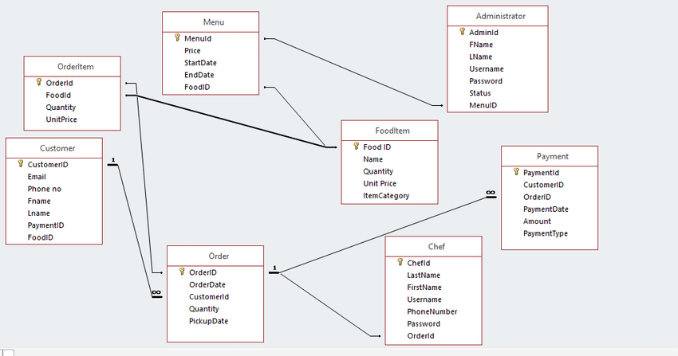
Database Design[2]

Slide 12
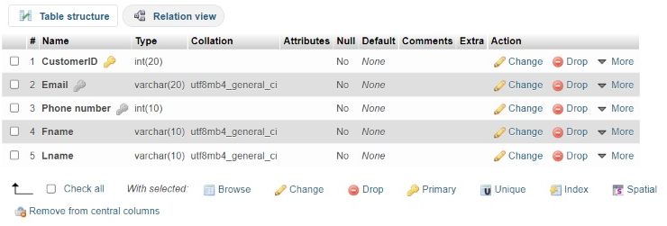
DATABASE DESIGN[3]

Slide 13
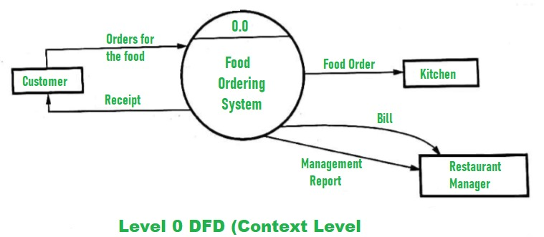
DFD / User Activity Diagram[4]

Slide 14
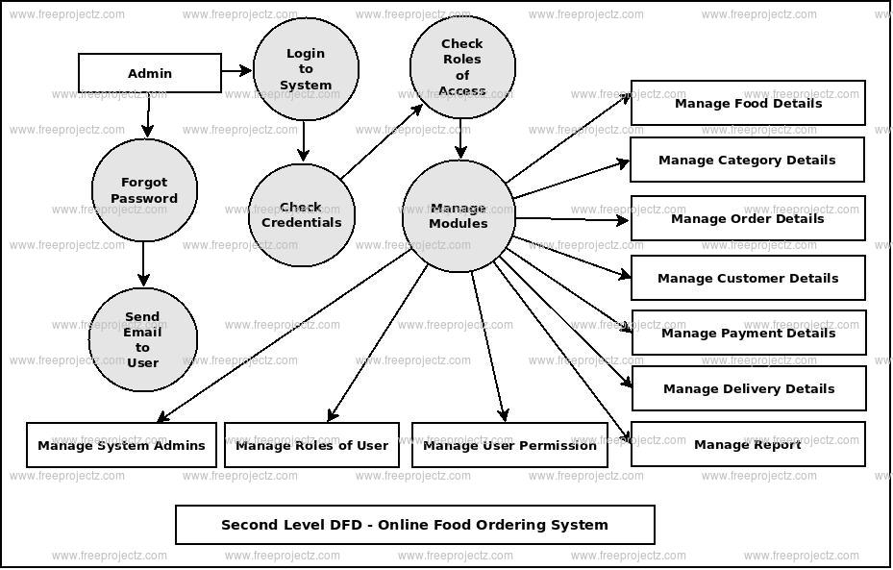
DFD / User Activity Diagram[5]

Slide 15
Conclusion
The aim of this project is to create a restaurant website that can solve all the existing problems and as well as includes many new features(example:- discount, home delivery service, etc)..
While placing an order over the phone, customer lacks the physical copy of the menu item, lack of visual confirmation that the order was placed correctly

Slide 16
References
Udemy
[1]https://app.diagrams.net
[2]https://www.researchgate.net/figure/Database-Schema-for-the-Restaurant-Ordering-System_fig4_323230406
[3]phpMyAdmin
[4] https://www.geeksforgeeks.org/dfd-for-food-ordering-system
[5]https://www.freeprojectz.com/dfd/restaurent-management-system-dataflow-diagram

